Slide 1
Jobs and Careers
Objective: Students will understand the difference between a Job and a Career.

Slide 2
Quick Questions: Jobs and Careers
What do you think is the difference between a job and a career?
Which would you prefer to have? Why?

Slide 3
Jobs
A particular task you are undertaking.
Paid or unpaid.
You will likely have many jobs throughout your lifetime.

Slide 4
Careers
You will have only one career.
It includes all your life’s work.
The work you have done so far is part of your career (career development.)

Slide 5
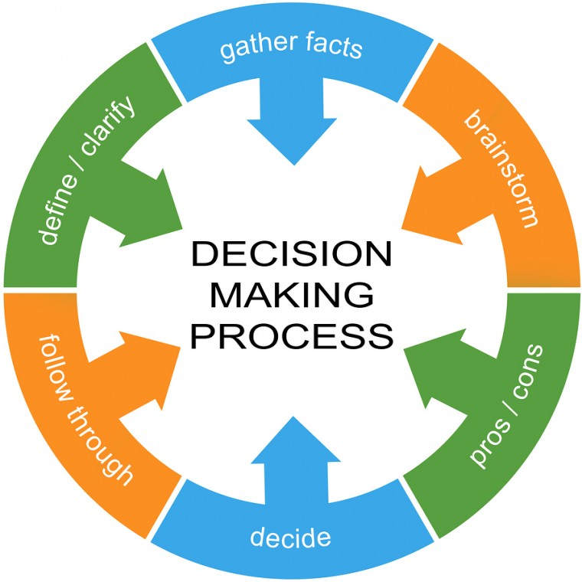
Making Career Choices
Decision making patterns.
Wishful thinking. (Eric)
Escape artist. (Louisa)
Play it safe. (Maggie)
Impulsive. (Wade)
Leave things to fate. (Andy)
Complaint. (Elena)
Procrastination. (Harold)
Agonize over every decision. (Yoko)
Makes decisions intuitively. (Arturo)
Rational approach to making decisions. (Kenisha)

Slide 6
Career Choices Short Essay
Select the decision maker(s) on pg. 20 that you are most similar to.
Once you have selected your decision makers, write a 1-page reflection about why you are the most like this person.
Use examples from past experiences.
Once you have described the decision maker that you ARE, describe the decision maker that YOU WOULD LIKE TO BE more like and why.

